Slide 1
Predicting Time to Adopt
Kaggle Competition: Petfinder.MY Adoption Prediction
Notes:
Thank you for taking the time to view this presentation. Kaggle is running a competition for forecasting the time to adopt for pets offered on the Petfinder.MY site. The site is for pets located in Malaysia.

Slide 2
PetFinder.my
Time to adopt highly correlated to features in pet descriptions
PetFinder is working to develop a photo based forecast
PetFinder is asking for tools to use for time to adopt
Notes:
PetFinder.MY has already done some analysis of the data and found strong correlations between pet descriptions and the time to adopt and is trying to add analysis of photographs to create a ‘cuteness’ meter based on the photographs. Part of this analysis which is not discussed did find that there are categories of photographs which more highly correlate to certain AdoptionSpeed categories. PetFinder is using this contest to further its own prediction goals.

Slide 3
PetFinder.my – Data
All data is provided by PetFinder
Provided data includes
Google Sentiment Analysis Data
Google Classification for Photographs
Posting data
Including Photographs
Focused on Petfinder provided posting data including photographs
Notes:
All of the data is provided by pet finder. It includes pet entry data and photographs. PetFinder.MY is also providing Google generated meta data. One is a classification of photographs and the other is a sentiment analysis of the descriptions. This analysis focused on using the photograph data and the pet entry information.

Slide 4
Data Selection
Narrowed data selection to photographs and provided data
Excluded Google generated data
Skeptical about data applicability
Preference to do own text analysis
Problems
Data more difficult to process
Larger dataset to handle
Notes:
When looking over the Google generated data it was found that the sentiment analysis provided was either a positive or negative entry. It was decided that a more detailed analysis would be beneficial. A lexicon was found which included words from several languages and included sentiments like trust, sadness, anger as well as positive and negative sentiment.
This presented problems such as learning how to process photographs and this resulted in a very large dataset.

Slide 5
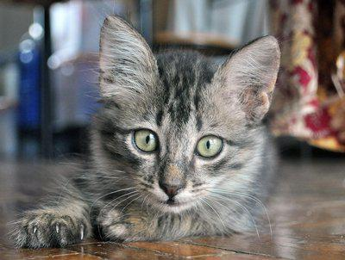
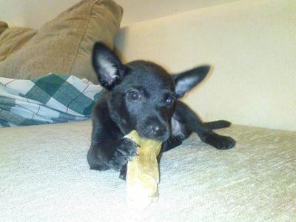
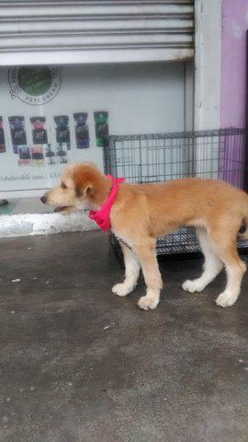
Photographs vary in size and quality
Notes:
The photographic data varied widely and in many dimensions. Here we see three examples of the photographs provided. As you can see the photo on the left is very high quality, well framed detailed and the subject is clear. In the second we see a washed out photograph with little detail. But there is high contrast and so may be easy for an algorithm to process. Finally the photograph on the left. We do not see great detail of the subject, we also have a photograph that has different dimensions than the other two.

Slide 6
Photograph Data
Photograph data
Transformed into vector representation using SVD procedure
Resized to 50x50 pixels
Retained RBG data (Red, Blue Green)
Each picture is a vector 7500 values long
Testing with Random Forest
RF can successfully ID fruit using this data
Notes:
Photographic data needs to be converted into a vector of values. This was done using the Single Value Decomposition process. The resulting data is a vector of small values, good for processing and friendly to Neural Nets, the most popular way of processing photographs.
To manage the vector size the data was reduced to 50 x 50 pixels, it is hoped that enough detail is preserved in these photos that they are useful. This also spares computation time.
Red Blue and Green data are preserved, it is thought color will be a significant factor in how the photographs are received. This results in vectors 7500 data points long.
A test using random forest was used on pictures of fruit to verify that alternate routes to classification will work on photographs.

Slide 7
Description Data
Google sentiment analysis provided a positive and negative
Description Data analyzed using single words
NRC Word-Emotion Association Lexicon (NRC Emotion Lexicon)
English only but could also easily be redone to include other languages
Notes:
Google sentiment analysis provided positive and negative sentiment data, but it is thought that other classifications would add more value to the data. The NRC Emotion Lexicon was used to obtain positive, negative and other sentiment data.

Slide 8
Data exploration
14993 Adoptions
All 13 States
54000+ photographs
Data Used
Used a subset of the data to speed up analysis
Training Subset 2415
Test Subset 489
Notes:
In the dataset there were 14993 adoptions in all 13 states in Malaysia and 54000+ photographs. Due to the size of the data it was decided that using a subset of data would be the best way to ensure methods could be tested by the end of the project.
The training subset was 2415 entries and the test subset 489 entries.
Only one photograph per entry was used.

Slide 9
Data Exploration
1225 Dogs, 1190 Cats
Same Day – 53
First Week – 493
First Month – 660
2nd & 3rd Month – 648
Beyond 100 days - 561
Notes:
The training data contained a nearly 50/50 split of dogs and cats. The Adoption Speed variable seems to be very consistent in the number of adoptions. Same day adoptions would be rare as choosing a pet and bringing it to a prepared home would take some time.

Slide 10
Data Exploration Total of 20
Health
Vaccinations
Dewormed
Sterilized
Location
Breed
Color
Size
& etc.

Slide 11
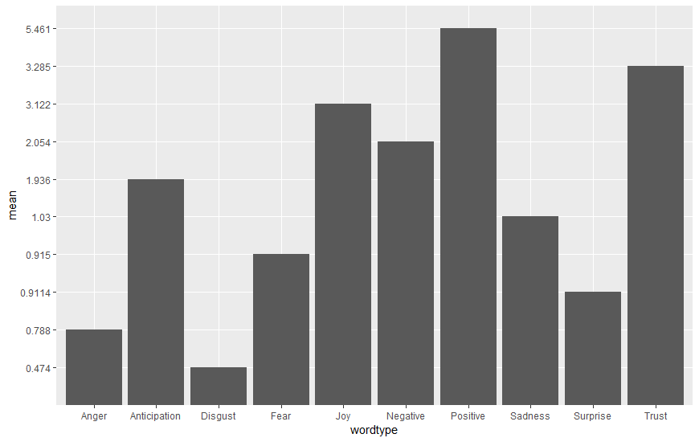
Word Type Distributions
Notes:
Processing the descriptions for sentiment analysis was done by breaking the descriptions down into individual words, removing stop words such as and or that or the. Then removing any words that did not appear in the lexicon.
Here we can see that this analysis shows that the descriptions tend to be positive, and use words that invoke feelings of trust, and joy.
When reading over the descriptions you see that the pet is often described as bringing happiness and that the poster of the entry wants to invoke trust in any individual that would adopt the pet.
Sadness also appears prominently, many of the descriptions included sad background stories for some pets.
The total number of these words are added up for each entry. The graph shows the average number of these words used in each description.

Slide 12
Corellation Table 1
 | positive | negative | anger | anticipation | disgust | AdoptionSpeed
positive | 1 | 0.696556164 | 0.57674265 | 0.81034802 | 0.52588209 | 0.013238
negative | 0.69655616 | 1 | 0.74173978 | 0.66551773 | 0.7451389 | -0.00192
anger | 0.57674265 | 0.741739776 | 1 | 0.54034206 | 0.59494198 | 0.032558
anticipation | 0.81034802 | 0.66551773 | 0.54034206 | 1 | 0.46606277 | 0.012341
disgust | 0.52588209 | 0.745138904 | 0.59494198 | 0.46606277 | 1 | -0.01769
fear | 0.60684912 | 0.803289972 | 0.73978831 | 0.62958053 | 0.62422874 | 0.038567
joy | 0.88935636 | 0.610254869 | 0.533218 | 0.74801473 | 0.47614749 | 0.010063
sadness | 0.58536733 | 0.816394354 | 0.63588235 | 0.58457408 | 0.57646482 | 0.007322
surprise | 0.64998825 | 0.548129424 | 0.57937635 | 0.65737447 | 0.43730476 | 0.023417
trust | 0.92786355 | 0.685275202 | 0.56630442 | 0.82020255 | 0.51184139 | 0.009631
AdoptionSpeed | 0.01323786 | -0.001916688 | 0.03255831 | 0.01234111 | -0.01768836 | 1
Notes:
To see if there were any obvious effects on the likelihood of adoption. There is no strong correlation found between any sentiment and AdoptionSpeed. This may be due to the factor form of AdoptionSpeed.

Slide 13
Corellation Table 2
 | fear | joy | sadness | surprise | trust | AdoptionSpeed
positive | 0.60684912 | 0.88935636 | 0.58536733 | 0.64998825 | 0.927863553 | 0.013238
negative | 0.80328997 | 0.61025487 | 0.816394354 | 0.54812942 | 0.685275202 | -0.00192
anger | 0.73978831 | 0.533218 | 0.63588235 | 0.57937635 | 0.566304419 | 0.032558
anticipation | 0.62958053 | 0.74801473 | 0.584574082 | 0.65737447 | 0.820202555 | 0.012341
disgust | 0.62422874 | 0.47614749 | 0.576464815 | 0.43730476 | 0.511841389 | -0.01769
fear | 1 | 0.50847889 | 0.715310947 | 0.50502375 | 0.596019692 | 0.038567
joy | 0.50847889 | 1 | 0.54222282 | 0.66834173 | 0.891513621 | 0.010063
sadness | 0.71531095 | 0.54222282 | 1 | 0.48598825 | 0.567468301 | 0.007322
surprise | 0.50502375 | 0.66834173 | 0.485988252 | 1 | 0.650603982 | 0.023417
trust | 0.59601969 | 0.89151362 | 0.567468301 | 0.65060398 | 1 | 0.009631
AdoptionSpeed | 0.03856658 | 0.01006281 | 0.007321523 | 0.02341741 | 0.009630921 | 1

Slide 14
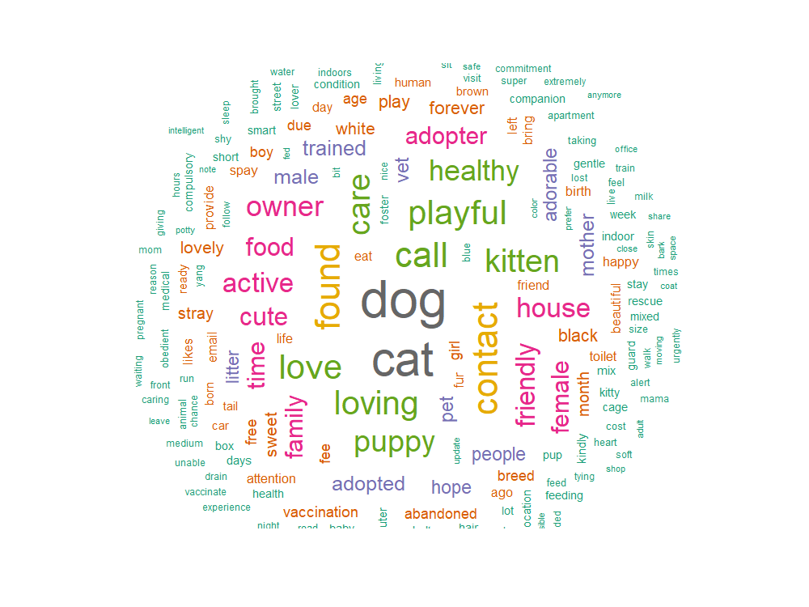
rquery.wordcloud() : Word cloud generator
http://www.sthda.com/english/wiki/word-cloud-generator-in-r-one-killer-function-to-do-everything-you-need#usage
Notes:
A word cloud was created to view the top used words. The type of pet figures prominently. With found and the contact information for the poster also appearing. Descriptive words appear.

Slide 15
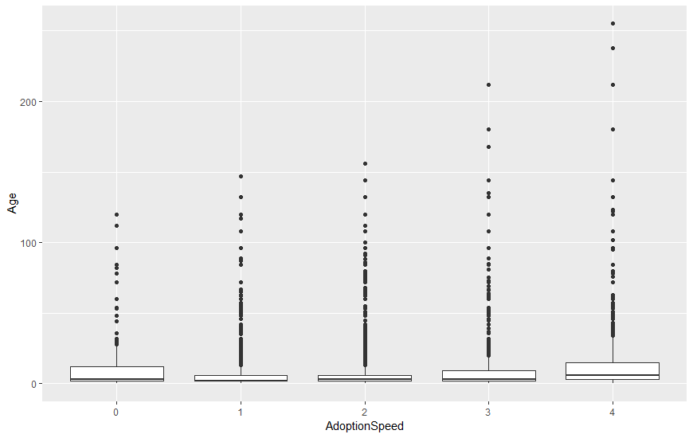
Adoption Speed vs. Age
Same Day | Same Week | First Month | 2nd and 3rd Months | Greater than 100 days
Age | Age | Age | Age | Age
Min. : 0.00 | Min. : 0.000 | Min. : 0.000 | Min. : 0.00 | Min. : 0.00
1st Qu.: 2.00 | 1st Qu.: 2.000 | 1st Qu.: 2.000 | 1st Qu.: 2.00 | 1st Qu.: 3.00
Median : 3.00 | Median : 2.000 | Median : 3.000 | Median : 3.00 | Median : 6.00
Mean : 10.45 | Mean : 8.488 | Mean : 8.824 | Mean : 10.19 | Mean : 13.67
3rd Qu.: 12.00 | 3rd Qu.: 6.000 | 3rd Qu.: 6.000 | 3rd Qu.: 9.00 | 3rd Qu.: 15.00
Max. :120.00 | Max. :147.000 | Max. :156.000 | Max. :212.00 | Max. :255.00
Notes:
It is common knowledge that younger pets are adopted more often and more quickly than older pets. Yet this trend is not totally obvious here. The outliers show this trend, yet the measures of center of age do not until we reach the greater than 100 days measure. The relationship certainly is not linear.

Slide 16
Cats Vs. Dogs
 | Same Day | First Week | First Month | 2nd & 3rd Month | More than 100 days
Dog | 0.006625259 | 0.0873706 | 0.137888199 | 0.148654244 | 0.126708075
Cat | 0.015320911 | 0.116770186 | 0.135403727 | 0.119668737 | 0.105590062
Notes:
It should be noted that there appears to be a difference in adopting cats and dogs. Cats are more likely to be adopted sooner. This may be due to the low maintenance reputation of cats. Cats are twice as likely to be adopted same day, more likely to be adopted in the first week. The advantage continues to show through the 2nd, 3rd and more than 100 days classifications.

Slide 17
Dogs Vs. Cats
There is surprisingly little variation between the dogs and cat sizes.
 | Small | Medium | Large | Extra Large
Dog | 165 | 962 | 97 | 1
Cat | 367 | 728 | 94 | 1
Notes:
Part of the possible reason is size. Yet Cats make up almost as many small and tiny classifications as dogs. Medium and Large are almost identical. Here we may be seeing the effect of self-reporting. There is no established rule for what is small medium large and so on. This could also be due to the real distributions of course.

Slide 18

Random Forest Importance
 | MeanDecreaseGini
positive | 23.55033
Type | 6.113998
Age | 29.397313
Gender | 11.337126
Color1 | 20.889334
Color2 | 25.062248
Color3 | 10.802243
MaturitySize | 9.383535
PhotoAmt | 31.921063
Notice how type and Maturity Size have surprisingly low Decrease Gini Coefficients
Interaction Variables may be called for. (Cat & Size, Dog & Size)
Notes:
One would expect that Maturity Size and Type would have a significant effect on which pet gets adopted. This suggests that interaction variables may enhance accuracy. Such as pet is cat and small, dog and large and so on. Small and medium sized animals did vary somewhat.

Slide 19
Model Testing
Naïve Bayes
K Nearest Neighbors
Random Forest
Notes:
Three models were successfully used in creating forecasts. Naïve Bayes, K Nearest Neighbors and Random Forest

Slide 20
Better than a random guess?
Used Cohen’s – Kappa to determine accuracy
Close to matching
-1 none match to 1 all match
Notes:
The measure we will use to check the usefulness of the forecast is if it is better than a random guess. Using the training set we obtained a set of probabilities, and using these probabilities generated 1000 sets of 489 “test” sets. From there a T-Test was used to compare against the predicted data.
Photograph and Text data (combined sentiment data and other data provided by the competition) were tested separately. This was to determine if the photo data was by itself useful. If a prediction better than random could be done using the photographs only then the two data sets were merged. The two data sets merged never produced a result that was better than just the provided and sentiment data.

Slide 21
Naïve Bayes Results
Unprocessed Photo Data
24% correct
Cohen’s Kappa: -.0023
Poor Match
Text Data Only
27% Correct
Cohen’s Kappa: .063
Poor Match
All Data Together
Cohen’s Kappa: .026
Notes:
Here we see the results of the naïve bayes forecasting. In neither case do we get a prediction that could be said to be better than a random guess.
One assumption of the Naïve Bayes is that the variables are independent. In the case of this data, certainly in the case of the photographs, independence is not present. If one pixel is one color it is likely that an adjacent pixel is the same or a similar color. In the case of the sentiment data, positive and negative sentiment correlates with the other sentiment measures (Trust and Positive) frequently appear together.

Slide 22
K-Nearest Neighbors Results
Text Only
43.8% Accuracy
Cohen’s Kappa: .26
Photographs
24.9% Accuracy
Cohen’s Kappa: -.0064
Notes:
K-Nearest Neighbors is more promising than Naïve Bayes due to the fact it makes no assumptions about the underlying data. We see that the text data is a stronger predictor than the photographs, which are no better than a random guess.

Slide 23
Random Forest Results
Text Only
57% Correct
Cohen’s Kappa: .43
Fair Match
Picture Data Only
22% Correct
Notes:
Random Forest is the strongest method for prediction in this case. The photographic data once again is no better than a random guess. The text data set has nearly a 55% success rate.

Slide 24
Clustered Photographs
Random Forest
56.4% match
Cohen’s Kappa .424
Fair Match
Compared to .43
Naïve Bayes
31.5% match
Cohen’s Kappa .11
Compared to .063
K-Nearest Neighbors
40.1% match
Cohen’s Kappa .212
Compared to .26

Slide 25
Analysis of predictors
Factors, numbers and descriptions were best
Photographic data only worked when classified
K-Means classification
Only for Naïve Bayes
Even then: poor match

Slide 26
Photographic contribution
Photographs were messy
Inconsistent sizes
Resized
Not all could be resized
Inconsistent angles, backgrounds etc.
Finding consistent patterns was clearly difficult for the algorithms
If Neural Networks can be properly applied results may improve.
If human classification can be used, results may improve.

Slide 27
PetFinder.MY
Prediction of Time to Adopt
Thank you for viewing! I look forward to your feedback!

